Slide 1
Chapter 15
Event-Driven Programming and Animations

Slide 2
Introduction
You can write code to process events such as a button click, mouse movement, and keystrokes.
To do this you will need an event source object and a handler
The event source object would be an object like a button where an action originates
This action is an event
The handler processes the event

Slide 3
EvenT Handler
The object must be an instance of the EventHandler<T extends Event> interface. This interface defines the common behavior for all handlers. <T extends Event> denotes that T is a generic type that is a subtype of Event.
The EventHandler object handler must be registered with the event source object using the method source.setOnAction(handler).

Slide 4
Events and event sources
An event is an object created from an event source. Firing an event means to create an event and delegate the handler to handle the event
Java GUI is a program that interacts with the user
This is called event driven programming
An event is a signal to the program like a mouse click
An event object contains properties pertaining to the event

Slide 5
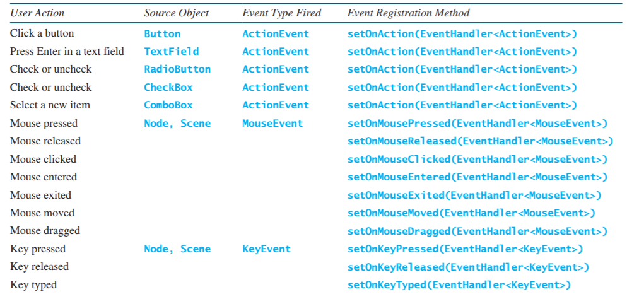
User actions

Slide 6
Registering Handlers and handling events
A handler is an object that must be registered with an event source object, and it must be an instance of an appropriate event-handling interface.
JavaFX defines a unified handler interface EventHandler<T extends Event> for an event T. Thehandler interface contains the handle(T e) method for processing the event. For example, the handler interface for ActionEvent is EventHandler<ActionEvent>;each handler for ActionEvent should implement the handle(ActionEvent e)method for processing an ActionEvent.
The handler object must be registered by the source object. Registration methods depend on the event type. For ActionEvent, the method is setOnAction. For amouse pressed event, the method is setOnMousePressed. For a key pressed event, the method is setOnKeyPressed.

Slide 7
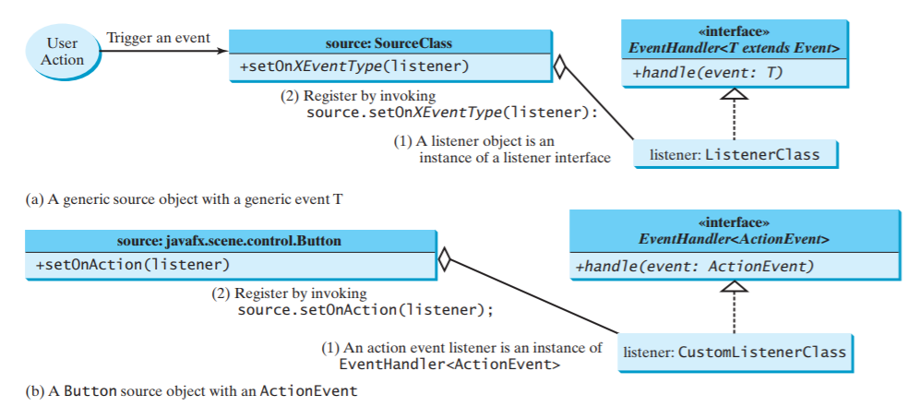

Slide 8
Inner classes
An inner class, or nested class, is a class defined within the scope of another class. Inner classes are useful for defining handler classes.
An inner class is compiled into a class named OuterClassName$InnerClassName. class.
An inner class can reference the data and the methods defined in the outer class in which it nestsAn inner class can be defined with a visibility modifier subject to the same visibility rules applied to a member of the class.
An inner class can be defined as static. A static inner class can be accessed using the outer class name. A static inner class cannot access nonstatic members of the outer class.
Objects of an inner class are often created in the outer class. But you can also create an object of an inner class from another class. If the inner class is nonstatic, you must first create an instance of the outer class, then use the following syntax to create an object for the inner class:
OuterClass.InnerClass innerObject = outerObject.new InnerClass();
If the inner class is static, use the following syntax to create an object for it:
OuterClass.InnerClass innerObject = new OuterClass.InnerClass();

Slide 9
Anonymous Inner Class Handlers
An anonymous inner class is an inner class without a name. It combines defining an inner class and creating an instance of the class into one step.
An anonymous inner class must always extend a superclass or implement an interface, but it cannot have an explicit extends or implements clause.
An anonymous inner class must implement all the abstract methods in the superclass or in the interface.
An anonymous inner class always uses the no-arg constructor from its superclass to create an instance. If an anonymous inner class implements an interface, the constructor is Object(). ■
An anonymous inner class is compiled into a class named OuterClassName$n. class. For example, if the outer class Test has two anonymous inner classes, they are compiled into Test$1.class and Test$2.class.

Slide 10
Simplifying Event Handling Using Lambda Expressions
Lambda expressions can be used to greatly simplify coding for event handling.
It is a anonymous class with a cocise syntax
The data type is infereed by the processor
It is treated like an object from an anoynomys inner class

Slide 11

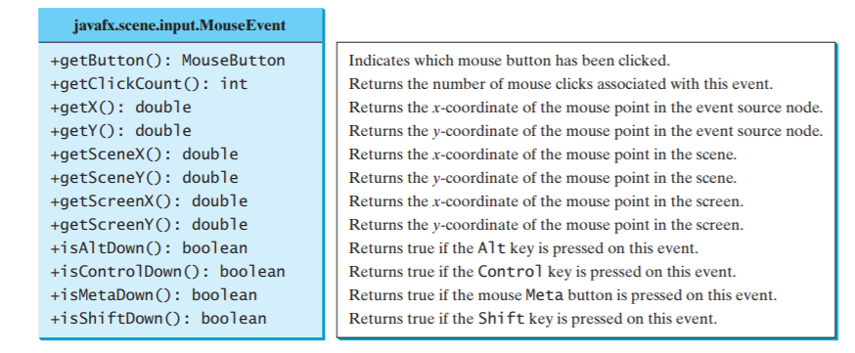
Mouse Events
A MouseEvent is fired whenever a mouse button is pressed, released, clicked, moved, or dragged on a node or a scene.
Four constants—PRIMARY, SECONDARY, MIDDLE, and NONE—are defined in MouseButton to indicate the left, right, middle, and none mouse buttons. You can use the getButton() method to detect which button is pressed.

Slide 12
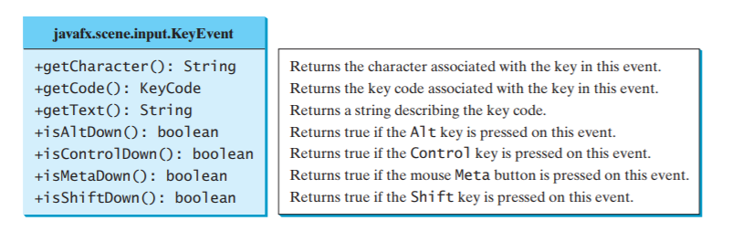
Key events
A KeyEvent is fired whenever a key is pressed, released, or typed on a node or a scene.

Slide 13
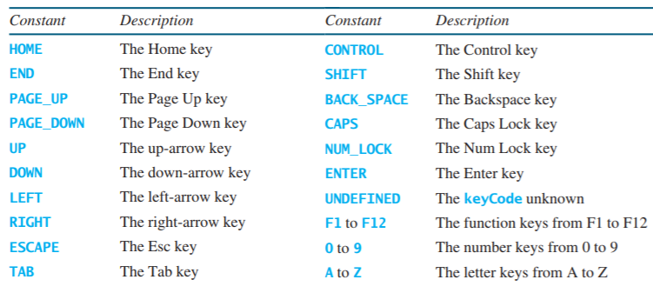
Key Code Constants

Slide 14
Listeners for Observable Objects
You can add a listener to process a value change in an observable object.
An instance of Observable is known as an observable object, which contains the addListener(InvalidationListener listener) method for adding a listener.
You must implement the listener class

Slide 15
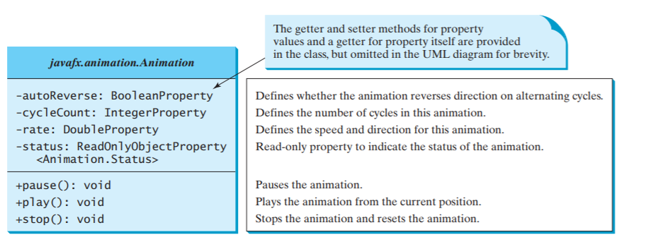
Animations
JavaFX provides the Animation class with the core functionality for all animations

Slide 16
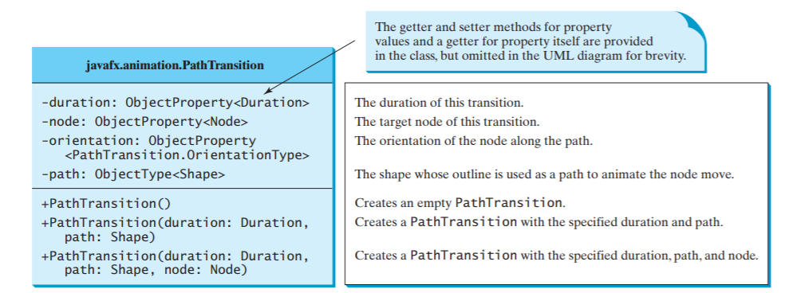
Path Transition
The PathTransition class animates the the moves of a node along a path from one end to the other over a given time.

Slide 17
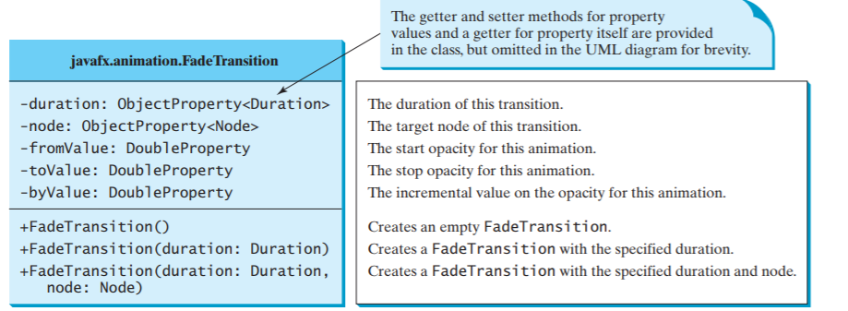
Fade Transition
The FadeTransition class animates the change of the opacity in a node over a given time.

Slide 18
Timeline
PathTransition and FadeTransition define specialized animations. The Timeline class can be used to program any animation using one or more KeyFrames.
Each KeyFrame is executed sequentially at a specified time interval.
Timeline inherits from Animation.

Slide 19
Summary pt.1
The root class of the JavaFX event classes is javafx.event.Event, which is a subclass of java.util.EventObject. The subclasses of Event deal with special types of events, such as action events, window events, mouse events, and key events. If a node can fire an event, any subclass of the node can fire the same type of event.
The handler object’s class must implement the corresponding event-handler interface. JavaFX provides a handler interface EventHandler for every event class T. The handler interface contains the handle(T e) method for handling event e.
. The handler object must be registered by the source object. Registration methods depend on the event type. For an action event, the method is setOnAction. For a mouse-pressed event, the method is setOnMousePressed. For a key-pressed event, the method is setOnKeyPressed.
An inner class, or nested class, is defined within the scope of another class. An inner class can reference the data and methods defined in the outer class in which it nests, so you need not pass the reference of the outer class to the constructor of the inner class.
An anonymous inner class can be used to shorten the code for event handling. Furthermore, a lambda expression can be used to greatly simplify the event-handling code for functional interface handlers.

Slide 20
Summary pt.2
A functional interface is an interface with exactly one abstract method. This is also known as a single abstract method (SAM) interface.
A MouseEvent is fired whenever a mouse button is pressed, released, clicked, moved, or dragged on a node or a scene. The getButton() method can be used to detect which mouse button is pressed for the event.
A KeyEvent is fired whenever a key is pressed, released, or typed on a node or a scene. The getCode() method can be used to return the code value for the key.
An instance of Observable is known as an observable object, which contains the addListener(InvalidationListener listener) method for adding a listener. Once the value is changed in the property, a listener is notified. The listener class should implement the InvalidationListener interface, which uses the invalidated method to handle the property value change.
The abstract Animation class provides the core functionalities for animations in JavaFX. PathTransition, FadeTransition, and Timeline are specialized classes for implementing animations.

